Slide 1


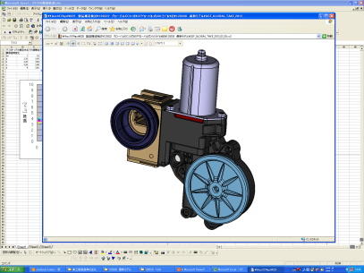
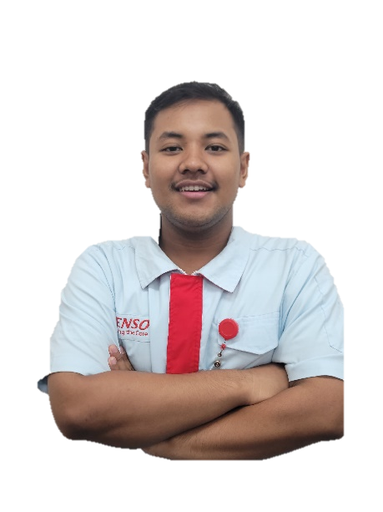
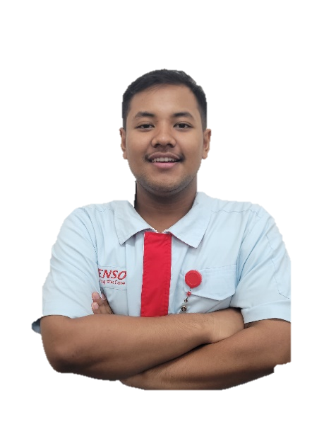


Final Report KOSEN #10
Date : 13/05/2024
Department : Manufacturing
Approved
Mr. Mahdy
Checked
Mr. Jarwo
Prepared
Reza
Already Approved
Nama : Reza Husen Anugrah
NIK : DM2260932
Line : 430-BF23 Assy #1
Content :
Introduction
Schedule activity
Product Knowladge
Layout line & Process Condition
OJT Activity & Skill in Production line
Case Study
Commitment & Future Plan
Background
Major
: Bekasi 1 Vocational High School
: Mechanical Engineering
ACCEPTING THE UNACCEPTABLE
MAKES YOU UNDEFEATABLE
Motto :

Slide 2



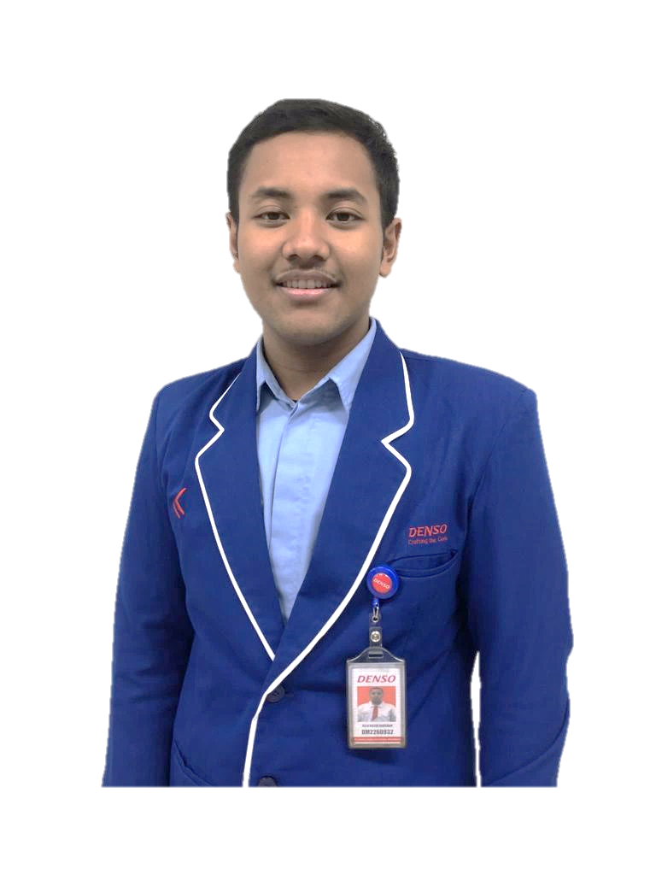
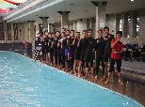
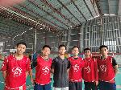
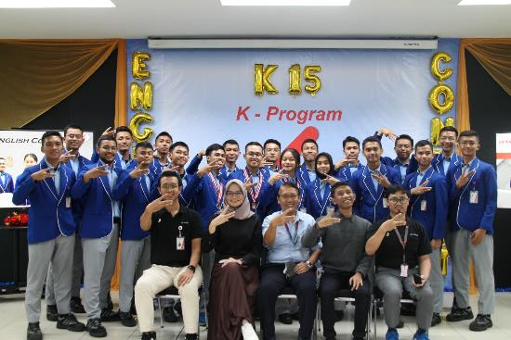
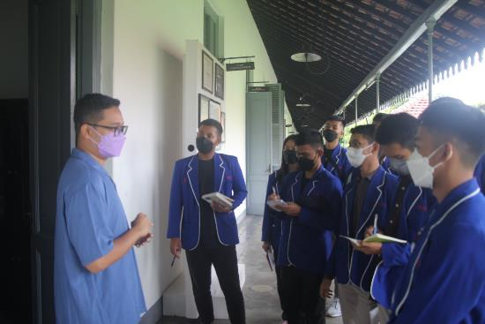


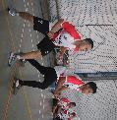
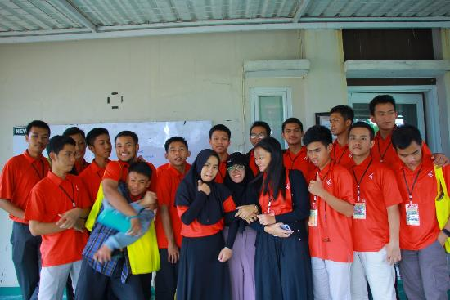
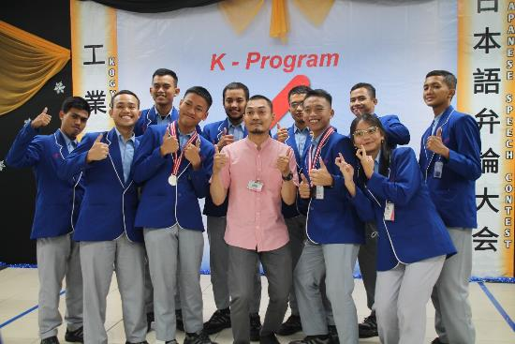
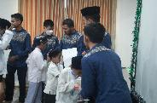
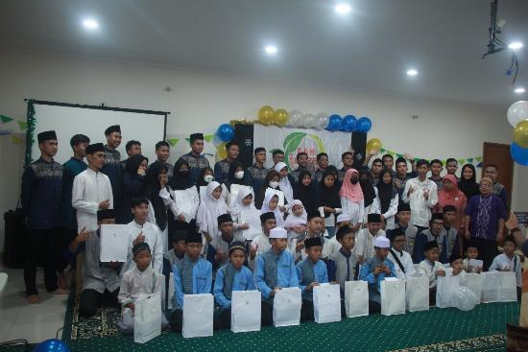
1. INTRODUCTION
2/13
A. EDUCATION
C. SKILLS
SMK Negri 1 Kota Bekasi → Mechanical Engineering
KOSEN Denso Manufacturing Indonesia
Polytechnic STMI Jakarta → Manufacturing Process
B. CERTIFICATION
Mentality & Leadership (RMBS)
BNSP Mechanical Inspection
BNSP Equipment Maintenance
IELTS Band 5.5
JLPT N5
AVERAGE SCORE IS 87.6
CAD Intermediate UNISMA
Highest Average score is Electronic
Lowest Average score is Manufacturing Process
Became Chief of Kosen
Sport Event
Educational Event
Social Event
Organize all activities that support kosen's targets in health and soft skills.
2 Years of Becoming KOSEN has Greatly Developed me
Notes:
I am Graduated from Vocational High School Bekasi City with Majoring Mechanical Engineering
And there is my certification and 2 years Actvity Becoming Kosen
Start form 1 year training at Dnia until placement at bf23
SO 2 Years of Becoming KOSEN has Greatly Developed me

Slide 3
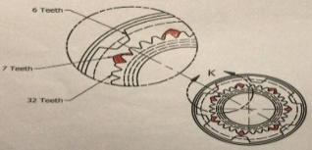
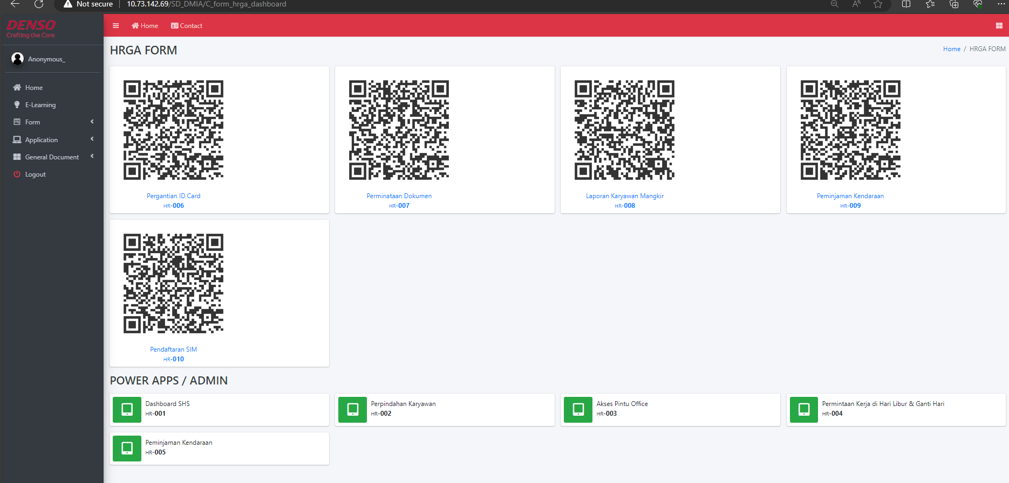
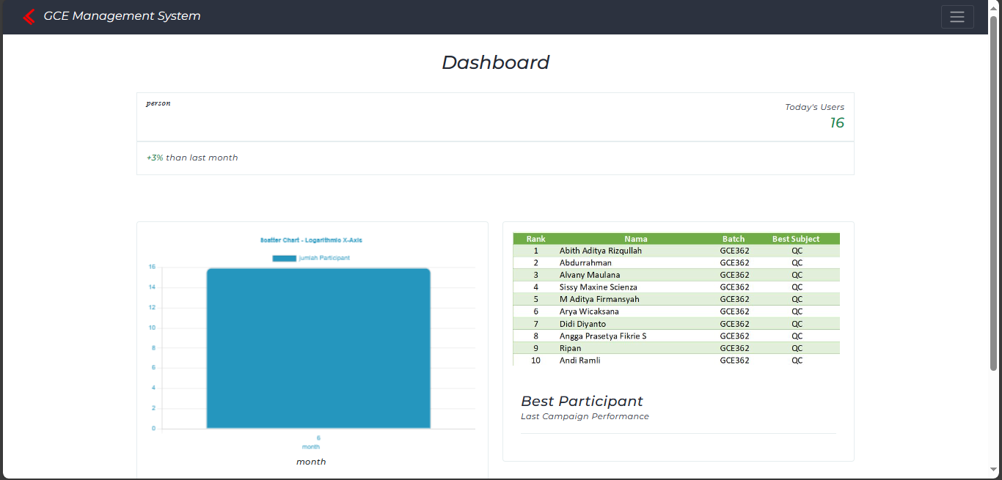
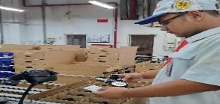
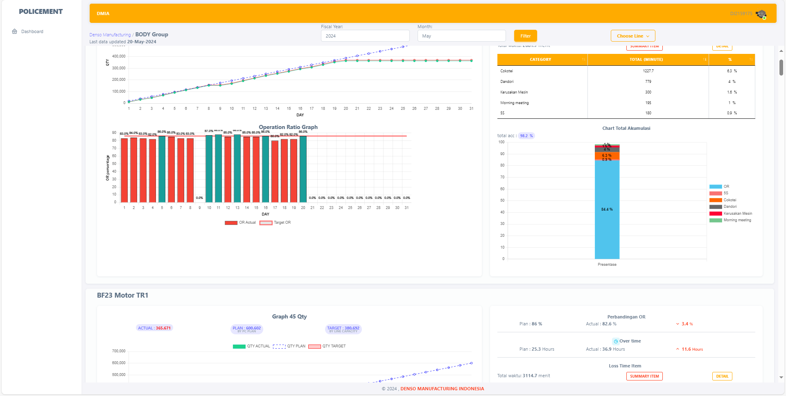
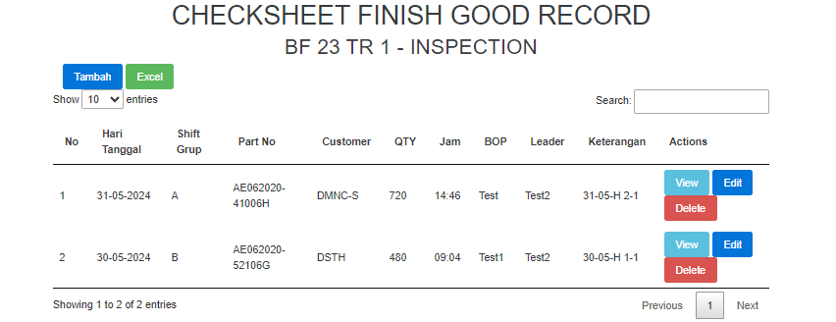
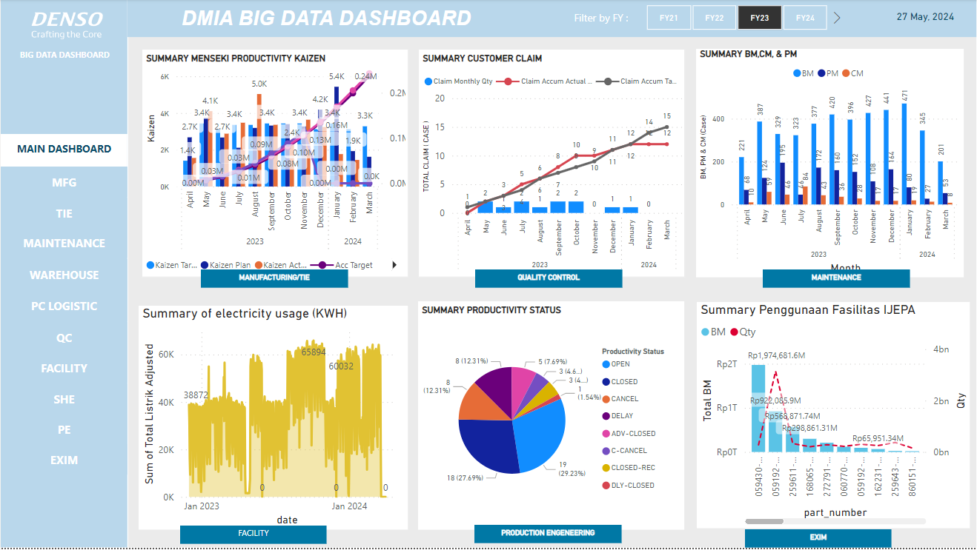
2. SCHEDULE ACTIVITY
3/13
Jul’22 – Jun’23
Jul’23
Aug – Dec’23
Jan’24
Feb’24 – Mar’24
Apr’24 – May’24
Training In-Out Class at DNIA
and make project :
KCA Tube Line 1
Design 3D Karakuri
Digital Smart Meeting Integration
Dojou Training
DX
TIE
BF23 LINE LEARNING
BF23 PROJECT
5 days training (Basic Manufacturing in DMIA)
Project digitalization and visualization
Learn about Basic TIE
Make SWC type 1 & 3 and MIFC in line BF23
Mizushumashi
PM Activity
Hassu Handling
Assy Rerunning
Packing
Dandory
Chokotei
Dandory Kaizen
Digitalization
BF23
1. Smart HRGA System
16 Atarimae
Aturan Dasar
5 Quality Commitment
5 Budaya Keselamatan
TIE System Productivity Achievement each line
SHS
Common Attachment
2. Visualization KPI All section DMIA
DISMI
POLICEMENT System
E - Check sheet F/G Record
BIG DATA visualization
SCHEDULE AT BF 23
The OJT at BF23 was 22 Days Line Learning and 35 days of KAIZEN

Slide 4
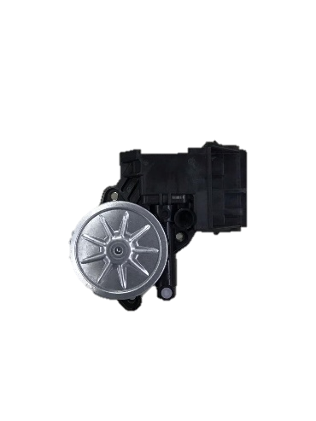
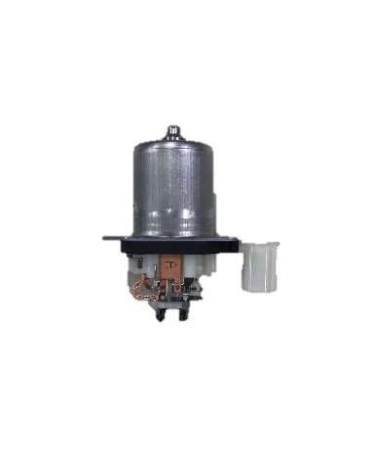
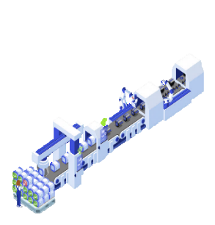
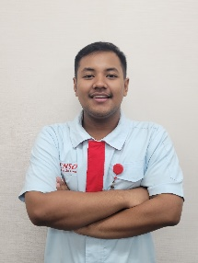
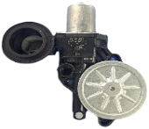
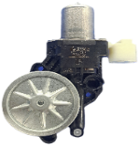
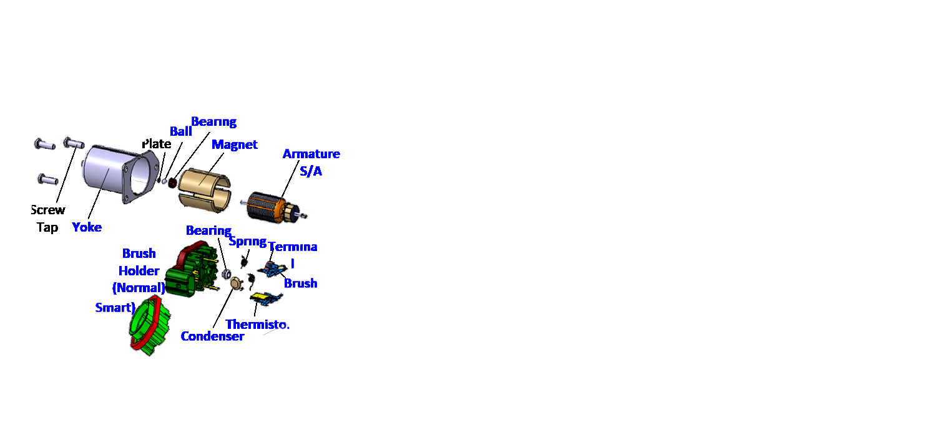
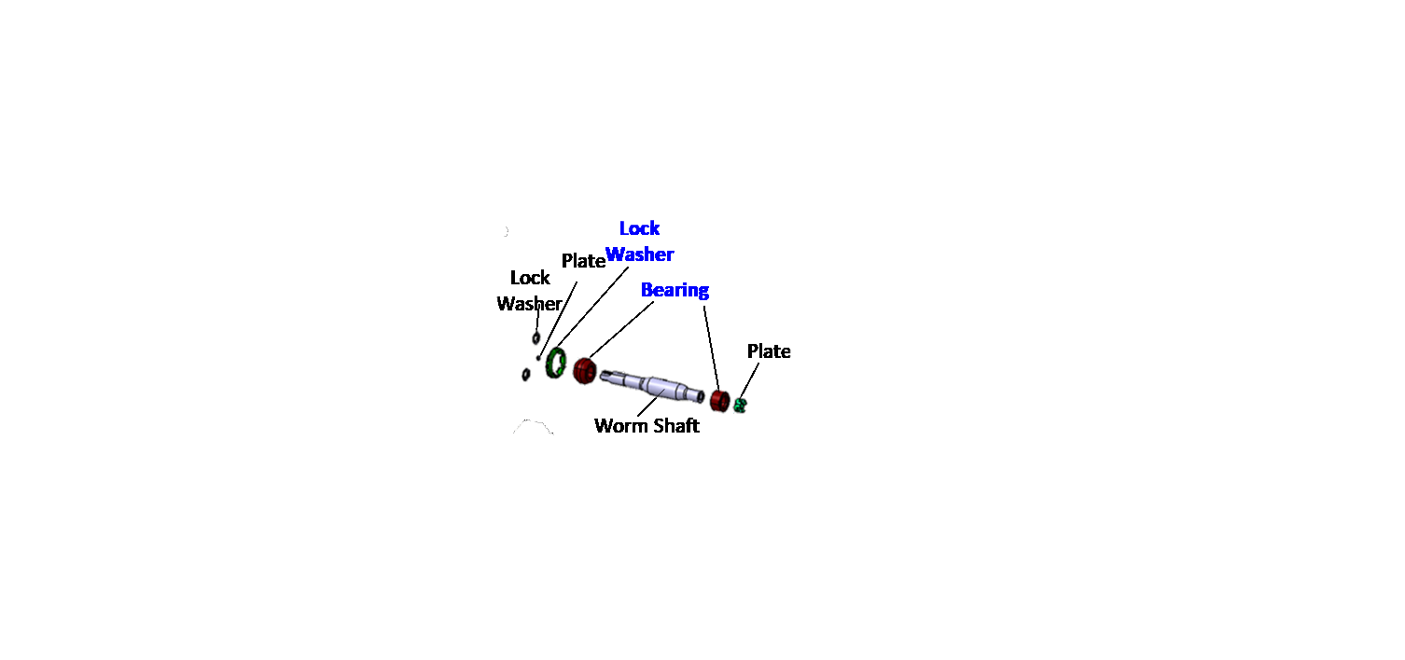
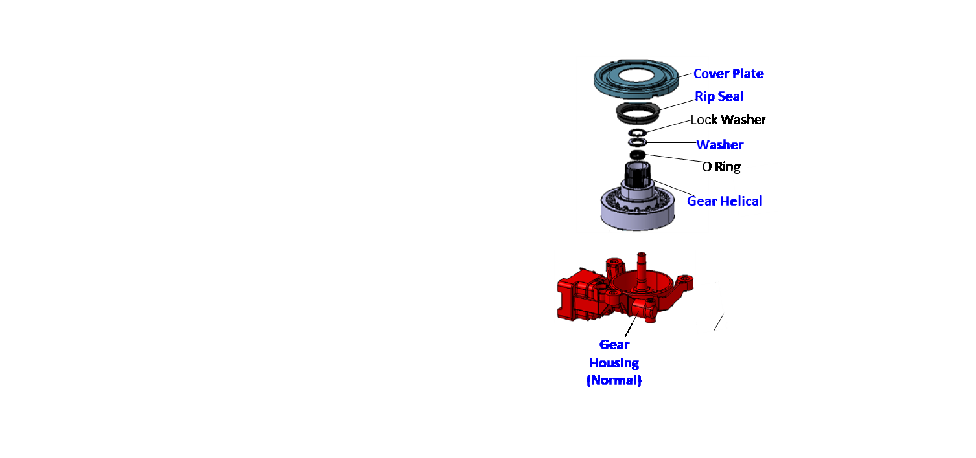
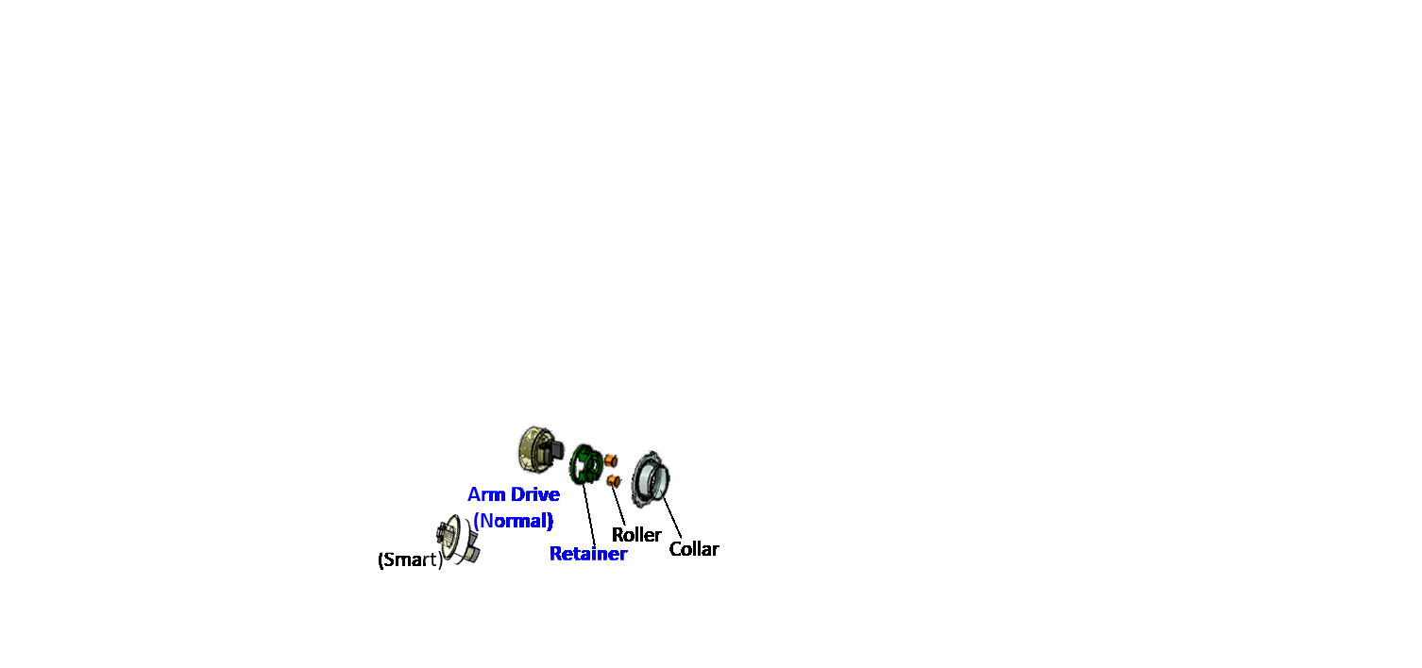
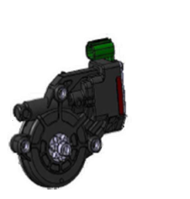
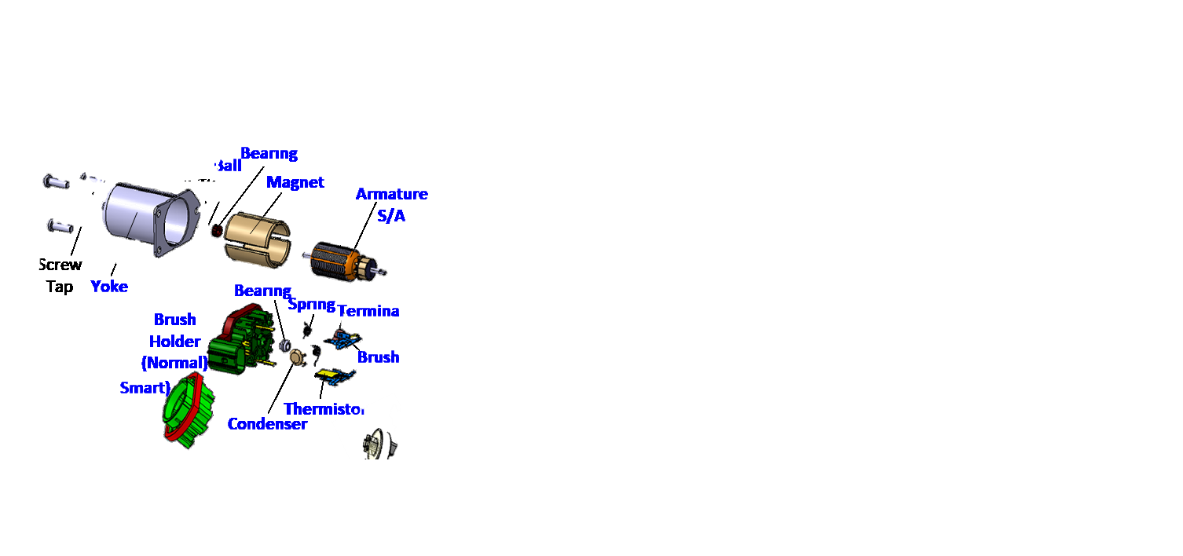
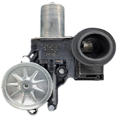

3. PRODUCT KNOWLADGE
4/13
A. BF-23 Product
As a driving motor, the power window consists of two components: the motor and the actuator(housing gear), which function raise and lower the car window by providing motion to the regulator crank system.
With Monthly Demand around 1.2 Million for Local and Export Customer
C. BF-23 Organization
Mr. Jaqin
(Director)
Mr. Joko
(GM)
Mr. Cecep
(SM)
B. BF-23 Line Production
Mr. Mahdy
(Mgr)
Transfer line
Tr1
Mr. Eko
(Spv)
Tr2
Tr1
Tr2
Is an automated system of connected machines or workstations used to sequentially process or assemble a product.
BF23 is one of the lines in DMIA that already use transfer lines. Actually as a Transfer line, BF-23 has a fast cycle time (2.7)
Mr. Mulyono
Mr. Mulyadi
(Hanchou)
Mr. Aris
Mr. Yoyo
(Hanchou)
Mr. Purwadi
(Foreman)
ME !
Reza Husen
Kosen #10
ME !
Reza Husen
KOSEN #10
D. 3 Models of Power Window
1. NORMAL AE262100 → DS, CP
Motor S/A
Housing S/A
Main Assy
2. SENSOR AE062040 → DS, CP
SMART
AE062020
DS, CP, & COROLLA
Housing
S/A
Motor
S/A
BF23 Have 3 Models of Power Window
Notes:
Bf 23 product is Power window, which consists of two components: the motor and the actuator(housing gear), which function raise and lower the car window by providing motion to the regulator crank system and bf 23 have 2 line production which the line is Transfer Line so this is the organization of bf 23 and Iam at the first line and bf23 have 3 models of power window there is normal, sensor, and smart

Slide 5
4. LAYOUT LINE & PROCESS CONDITION (LINE #1)
5/13
CT = 2.7 Second
1. Motor SA Line
2. Housing SA Line
H/G Supply, Plate Assy, Bearing Assy, Grease Apply
Smart Terminal Supply
B-1
B-2
B-3
B-4
B-5
B-6
B-7
B-8
B-1
B-2
B-3
B-4
B-5
B-6
B-7
B-8
B-9
B-10
1. Motor SA Line
PIC Machine
Flow
Terminal Supply, Thermistor Assy
Shaft Worm Supply, Bearing Insert, Shaft Worm Assy
B-1
B-2
B-3
B-4
B-5
B-6
B-7
B-8
B-11
B-12
Bearing Assy, Washer Lock Assy, Housing Discharging
B-10 | B-9 | B-8 | B-7 | B-6 | B-5 | B-4 | B-3 | B-2 | B-1
Welding Thermistor, Terminal Bending
B-12 | B-11 | B-10 | B-9 | B-8 | B-7 | B-6 | B-5 | B-4 | B-3
Brush Supply, Pigtail Caulking, Brush S/A Discharging
Housing Loading, Gear Grease Apply, Gear Helical Assy
C
C
C
C
Brush S/A Loading, Holder Brush Loading, Vacuum Suction
Lip Seal Assy, Greasing, O-ring Assy, Washer Assy, Washer Lock Assy
Visual Check
Mizusumashi 1
Mizusumashi 2
Bearing Press Fit, Brush S/A Assy, Image Check
Rubber Cushion Loading, Plate End Loading, Lip Seal Press, Shaft Drive Assy
2. Housing SA Line
Welding Terminal, Bus Bar Cutting, Cleaning Suction
O-Ring Assy, Shaft Grease Apply, Shaft Drive Assy, C-Ring Apply
Total :
4 SUB LINE
41 Block Process
133 Model F/G
Flow
Mizusumashi
Condensor Assy, Thermistor Resistance Check, Holder S/A Turning
Housing Transfer, Greasing
Housing Supply
Cover Assy, Cover Caulking, Housing S/A Discharging
B-9
B-4 | B-5 | B-6 | B-7 | B-8 | B-9
Bearing Centering, Armature Assy
B-1 | B-2 | B-3 | B-4 | B-5 | B-6
Stator Press Fitting, Magnetizing
Motor S/A Turning, Spring Assy, Image Check
PIC Machine
C
Centering, NG Discharging, Motor S/A Discharging
3. Main Assy Line
PIC Machine
Conveyor System
B-8 | B-7 | B-6 | B-5 | B-4 | B-2
B-1
3. Main Assy Line
4. Inspection Line
B-9
B-8 | B-7 | B-6 | B-5 | B-4 | B-3
Housing S/A Supply, Colar Press Fitting, Push Nut Press
Assy Supplying, Image Check, Assy Turning
B-1
B-2
B-3
B-4
B-5
B-6
B-7
B-8
B-1
B-2
B-3
B-4
B-5
B-6
B-7
B-8
C
C
C
C
Assy Supply
Serration Positioning, Roller Supply, Retainer Assy, Grease Apply
B-1
B-2
B-3
B-4
B-5
B-6
B-7
B-9
B-10
B-11
Mizusumashi
Performance, Noise & Vibration Check
Arm Drive Supplying, Arm Drive Magnetizing, Arm Drive Loading
Performance, Noise & Vibration Check
Conveyor System
Motor S/A Loading, Pig Tail Forming
Performance, Noise & Vibration Check
Serration Mapping, Motor S/A-Arm Drive Assy, Shaft End Greasing, Plate Assy
Performance, Noise & Vibration Check
4. Inspection Line
Mizusumashi
Visual Check
Serration Indexing, Clutch Check, Plate Grease Apply, Motor S/A Assy
Performance, Noise & Vibration Check
B-11
Screw Tightening, Assy Discharging
Performance, Noise & Vibration Check
B-1 | B-2 | B-3 | B-4 | B-5 | B-6 | B-7 | B-8
B-9 | B-10
Assy Loading, Injection Molding
Blade Check, Connector S/A Assy
Assy Turning, Isolation Check, Assy Discharging, Laser Marking
B-9
Data Writing
C
C
C
C
C
C
C
BOP Packing
Leak Test
PIC Machine
Pipe Assy, Laser Marking 1, NG & Assy Discharging, Laser Marking 2
The OJT was at BF23 Line 1 INSPECTION
Notes:
And as we can see this is layout line of the first line from bf 23 with CT 2.7. AND HAVE 4 S/A THERE IS MOTOR, HOUSING, MAIN ASSY, AND INSPECTION AND MY OJT WAS at BF23 INSPECTION LINE

Slide 6
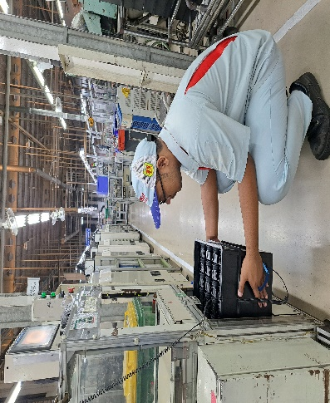
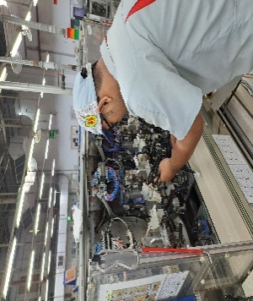


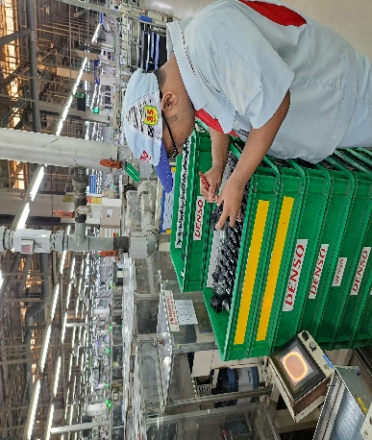
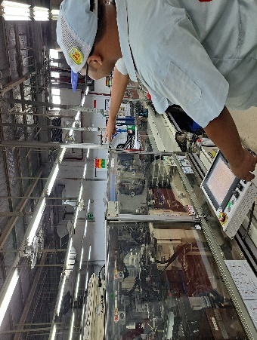

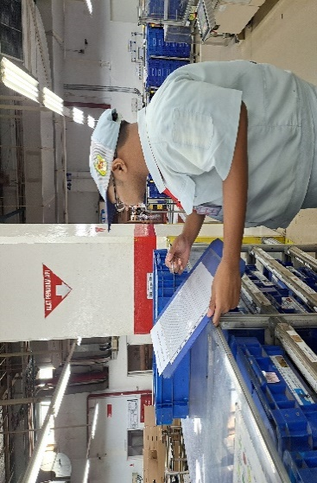

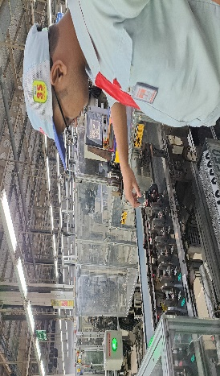
5. OJT ACTIVITY
6/13
On Job Training Activities
Product & Proses Knoladge
PM
Understanding of product BF23
Understanding the work system in the production line.
Understanding process of machine (Safety, quality).
Assy Supply Rerunning
Packer
Chokotei
MATRIX SKILL AT INSPECTION
BEFORE
AFTER
Hassu Handling
Packer
Dandory
Mizusumashi
Understand Production line Seriously to Achieve the goals as future leader

Slide 7
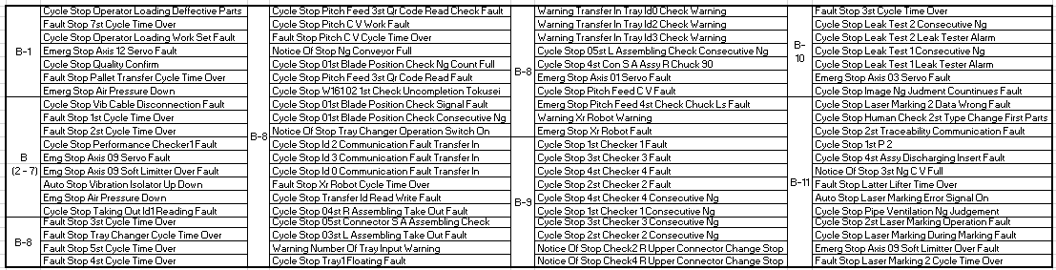
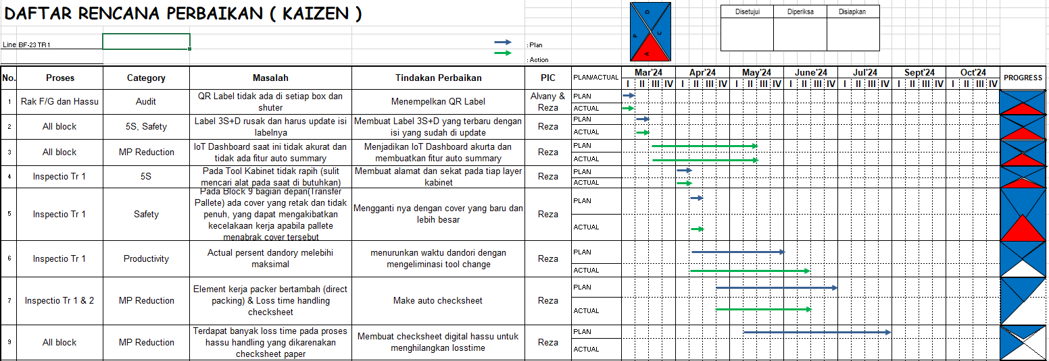
SKILL IN PRODUCTION LINE & KAIZEN SHEET
7/13
CHOKOTEI THAT I CAN HANDLE
I have 8 kaizen in BF23 and 2 kaizen I will present

Slide 8

6. CASE STUDY 1 : DANDORY KAIZEN
8/13
CURRENT CONDITION
1
OR INSPECTION MARCH ‘24
2
2 TYPE OF DANDORY
Without Attachment
With Attachment 2. Without Attachment
5%
Average /Day = 6 Times
3
FREQUENCY OF DANDORY
Date (On March’24)
With Attachment
Average /Day = 4 Times
3 Attachment :
Drive Shaft (7 Teeth)
Corolla (32 Teeth)
84%
Central Post (6 Teeth)
DURATION OF DANDORY (1x Dandory )
4
1
1x Dandory without attachment = 61’’
2 TYPE OF DANDORY
Without Attachment
X
Average/Day
16.8 s
Duration
61 Second x 6 Times
45,4s X 6 M/C = 272 S
= 361 second / Day
2
1x Dandory with attachment = 333’’
With Attachment
X
Average/Day
Duration
272 Second x 4 Times
44.2 s
= 1088 second / Day
There are 2 Types of Dandory at INSPECTION Tr1

Slide 9
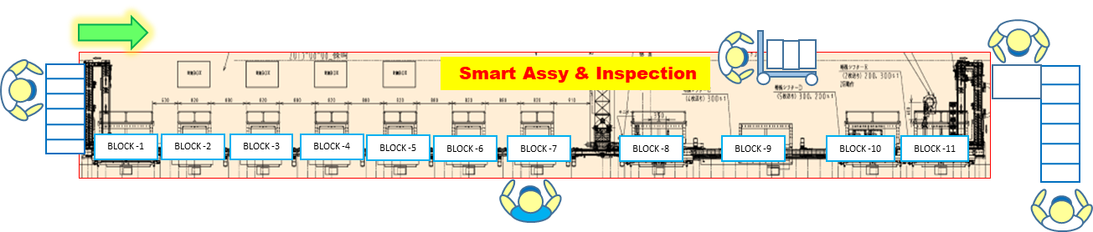

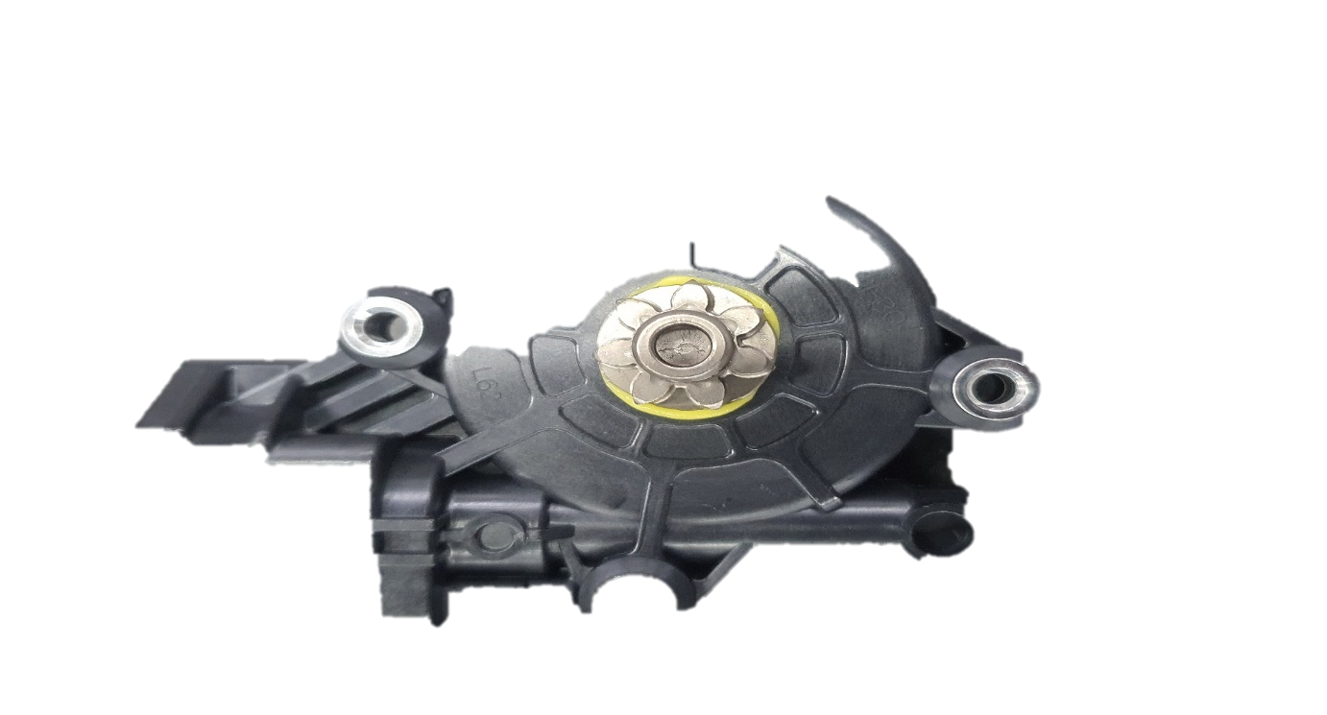
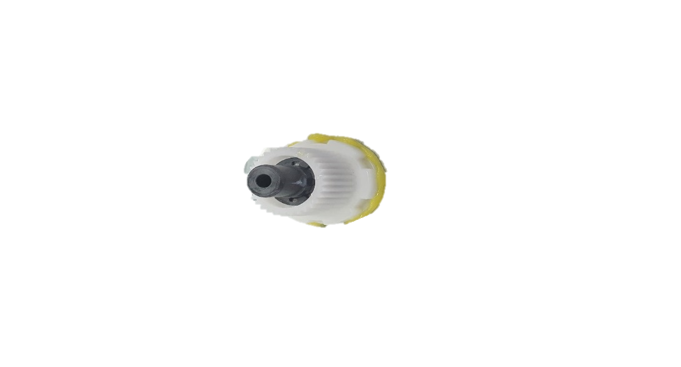
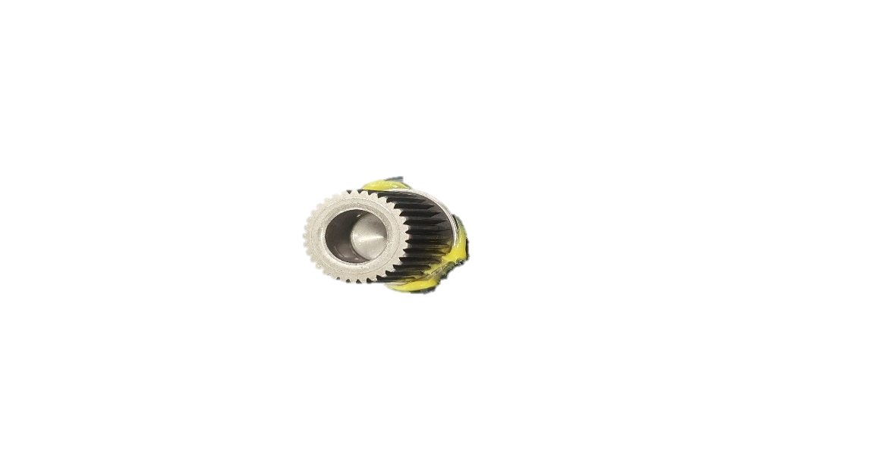

6. CASE STUDY 1 : DANDORY KAIZEN
9/13
DANDORY CHANGE ATTACHMENT
3
Visual Check
1
Part Supply
Leader
2
Rak Hassu
Packing
3 Attachment :
Drive Shaft (7 Teeth)
Center Post (6 Teeth)
Corolla (32 Teeth)
PROBLEM
5
OR INSPECTION MARCH ‘24
Without Attachment
5%
= 361 second / Day
Attachment is TOOL for TOKUSEI REACHIVE LOAD OF POWER WINDOW INSPECTION RESULT
CONVERSION To OR
361
72000
=
0,5%
For 3 Models of Shaft Drive
With Attachment
84%
= 1088 second / Day
CONVERSION To OR
=
1088
72000
1,5%
MAXIMUM = 3% ACTUAL = 5% OVER = 2%
Drive Shaft
2. Center Post
3. Corolla
1.5% of Dandory come from CHANGE ATTACHMENT

Slide 10

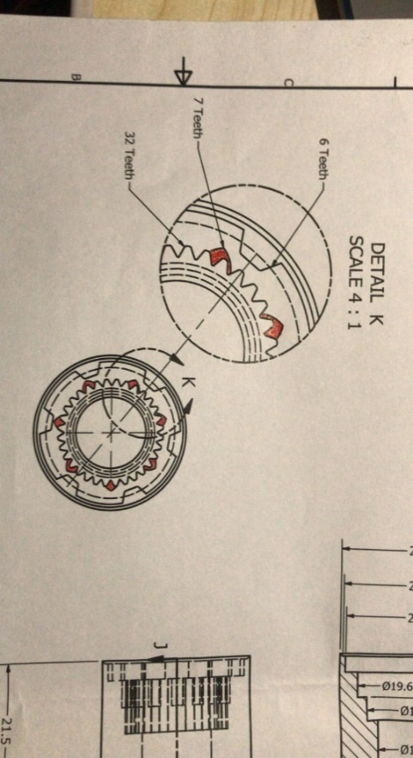
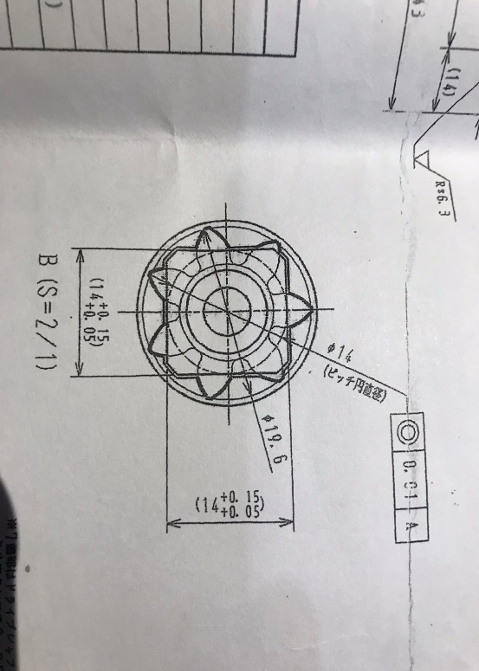

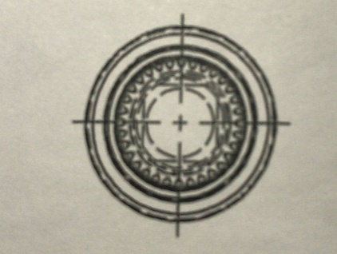
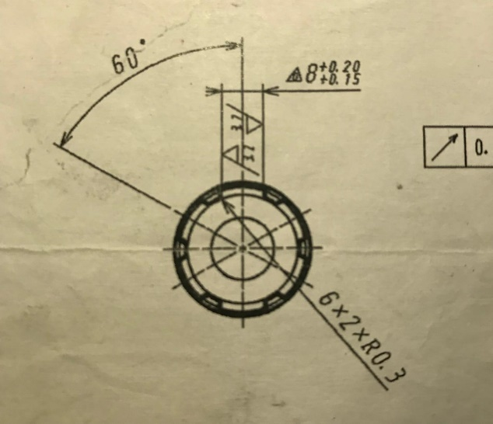
6. CASE STUDY 1 : DANDORY KAIZEN
10/13
IMPROVEMENT
PURPOUSE & TARGET
ACTIVITY PLAN
1
Way of Thinking
3
2
Create Common Attachment to ELIMINATE DANDORY CHANGE ATTACHMENT
Achieve Maximum of Dandory by Eliminate Change Attachment
Create 3 designs for combining 3 attachment models into 1 attachment
Create 1 New IK
OR UP 1,5%
NEW DESIGN
3
3 ATTACHMENT
1 COMMON ATTACHMENT
DRIVE SHAFT
Pattern : 7 Teeth
Pattern Diameter : 19.6 mm
Pattern Depth : 7 mm
DETAIL
COROLLA
Pattern : 32 Teeth
Pattern Diameter : 18 mm
Pattern Depth : 12 mm
CONCEPT #1
Pattern : 7 Teeth, 32 Teeth, & 6 Teeth
Pattern Diameter : 19.6, 18, 24 & 21 (mm)
Pattern Depth : 7, 12, 3.5 & 15.5 (mm
CENTRAL POST
Pattern : 6 Teeth
Pattern Diameter : 24 mm & 21 mm
Pattern Depth : 3.5 mm & 15.5 mm
WHY SUPPLIER ?
Our Workshop does not have high precision Machining
The order is in progress
Notes:
Talk about duration of dandory first, the total duration from elemental work of part supply is 16. 8 second
Second, the total duration from elemental work of part change attachment is 45.4 second and there are have 6 machine to change attachment so the total of 6 machine is 272 second

Slide 11


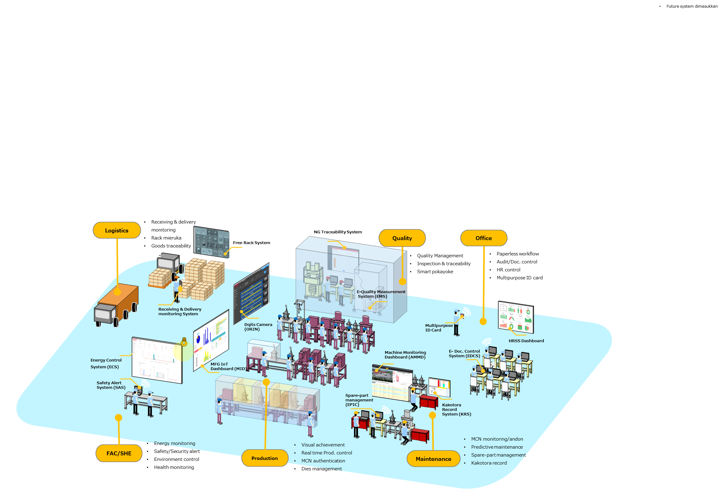




















5. CASE STUDY 2 : DIGITALIZATION IMPLEMENTATION
11/13
Management Policy
WAY OF THINGKING
SMART Manufacturing Company 2026
Efficiency Operation with Digital System
LOGISTICS
NG TRACEABILITY SYSTEM
QUALITY
OFFICE
Free Rack System
QUALITY MANAGEMENT
PAPERLESS WORKFLOW AND DOC CONTROL
GOALS
Receiving & Delivery Monitoring System
Multipurpose ID Card
100%
Digitalize System at BF-23 Inspection
Dqits Camera (ORIN)
Machine Monitoring Dashboard (AMMD)
E-Doc Control System (EDCS)
HRSS Dashboard
Energy Control System (ECS)
MFG IoT Dashboard (MID)
Digitalization of Work
PURPOSE
Safety Alert System (SAS)
Spare-part Management (EPIC)
Create Digital System to ELIMINATE LOST TIME and PAPER USAGE
Create Digital System to increase Accuracy data
Create system that ZERO COST
Kakotora Record System (KKS)
FAC/SHE
SHE MONITORING
PRODUCTION
REAL TIME PRODUCTION CONTROL
MAINTENANCE
MAINTENANCE MONITORING
Improve business practice by digitalization of work throughout the company
4
TARGET
E- Checksheet Hassu
Integration & Automation
Digitalize 1 Check sheet
Saving man hour 1 Hours / month and Reduce paper 1 RIM/Year
Speed Up DX Roadmap
Checksheet Hassu
IMPROVEMENT
Digitalization & Visualization
NVA Job
(Non-value added)
Big Data & Artificial Intelligence ^{(AI)}
Eliminate inter-section manual check
Profit
Refine & stabilize standard operation
OEE
Automatic Man Power adjustment
Checksheet F/G
Auto from BHT
Supplier→Customer traceability
Analytical predictive maintenance
Big Data & Artificial Intelligence ^{(AI)}
Fast problem detection & Kaizen
100% System Integration
100% Smart Analysis
Support Direct Packing by Eliminate Regullar Job (fill out paper checksheet of number pallete)
5
SCHEDULE ACTIVITY
DETAIL
100% Data Visualization
Checksheet Retry Tokusei
Checksheet Retry Data Writing
Checksheet NG Tokusei
Checksheet NG Atsumore
Current Condition
LOST TIME
BOP Fills out the Paper Checksheet by looking at the panel every end of shift
30 Minutes
Search for files in file room
40 Minutes
Paper preparation
Every new month
4 CHECKSHEET
Are still paper-based
IMPROVEMENT
MANUAL
I
Case
AUTO
Packing Record
Hassu
Retry Tokusei & Atsumore
Retry Data Writing
10 Minutes Daily Manual record
The Checksheet will be AUTO fill an get the data directly from machine using IoT Database
BF-23 INSPECTION OPERATION
Difficult Summary
3 RIM/ year
Spent Paper
BF23 Do Digitalization for DMIA Transformation Digital

Slide 12





5. CASE STUDY 2 : AUTO CHECK SHEET PACKING
12/13
WAY OF THINGKING
GOALS
SCHEDULE ACTIVITY
BEFORE DIGITAL
I
TARGET
1.
6. Write TIME OF PRINT OUT OUTER
9.
CYCLE = PER 1 PALLETE
4
DETAIL ACTIVITY
AFTER DIGITAL
THE APP ALREADY IN MFG PORTAL, SO BOP WILL STAND BY OPEN THE APP
1. KLICK TO AUTO FILL
ADVANTAGES OF DIGITAL
Simpler to Fill
Stored Data > 5 Years
Can Export Excel
No need Physical Storage
Fast to Summary
Fast to Search Data
Eliminate Paper Usage
Eliminate Paper Preparation
Checksheet Hassu
IMPROVEMENT
E- Checksheet Hassu
2. FILL BOP
Checksheet F/G
Auto from BHT
3. FILL LEADER
Support Direct Packing by Eliminate Regullar Job (fill out paper checksheet of number pallete)
DETAIL
4. KLICK
Checksheet Retry Tokusei
Checksheet Retry Data Writing
Checksheet NG Tokusei
Checksheet NG Atsumore
BOP Fills out the Paper Checksheet by looking at the panel every end of shift
The System is UNDER DEVELOPMENT
IMPROVEMENT
MANUAL
AUTO
The Checksheet will be AUTO fill an get the data directly from machine using IoT Database

Slide 13









➉ CASE STUDY 2 : IOT DASHBOARD IMPLEMENTATION
13/16
Way Of Thinking
Schedule Activity
IoT Dashboard is a good system to visualize data from machine.
Activity | PIC | March |  |  |  | April |  |  |  | May
 |  | I | II | III | IV | I | II | III | IV | I | II | III | IV
Problem 1 : Unknown Loss Data
1. Unknown loss Analysis | KOSEN
2. Discuss with DX Team | KOSEN, MFG, DX
3. Discuss with Bitmaker | KOSEN, MFG, DX, Vendor
4. Development IoT | Vendor
5. Trial And Error | KOSEN
6. Monitoring | KOSEN
Problem 2 : No Summary Data
1. Discuss with DX Team | KOSEN, DX
2. Discuss with SPV BF23 | KOSEN, MFG
3. Development | KOSEN
4. Trial and Error | KOSEN, MFG
5. Monitoring | KOSEN
OPERATION RATIO
DEFECT
CHOKOTEI
DANDORY
Until Now NOT USED PROPERLY
Because in IoT Dashboard :
High percentage unknown loss and data chokotei less than 1 percent/day
There is No Summary to analyze
Problem 1 : Unknown Loss Data
Problem Analysis
TRIGGER TO RECORD
START RECORD
END RECORD
Some handling Chokotei “Master ON” must be True
MASTER
ON
X
MASTER
ON
MASTER
ON
IoT Dashboard is a good system to visualize data from machine.
Visualize real-time and accurate data from machine
Auto alert (Notification) of Tools & Material Change, for fast action from MFG/MTN
Store data > 1 year
Integrate to the production control system, which aims to eliminate manual input
Notification of Chokotei (True) + Master ON (False)
Notification of Chokotei (false) + Master ON (True)
What We Do?
Data IoT DOES NOT MATCH with Actual Genba
Discuss with MAINTENANCE About memory PLC in actual machines
Create chokotei handling pattern discuss with PIC Line
Machine is having problem
Some Problem data is not recorded in IoT
LOW Chokotei data & HIGH Unknown data
TRIGGER TO RECORD DATA IS WRONG
Data IoT Dashboard not used properly because the data not match with actual genba
Notes:
OK, Next case study two about IOT DASHBOARD IMPLEMENTATION
This is way of thinking
IoT Dashboard is a good system to visualize data from machine.
But Currently BF23 has IoT but it is not used properly
Why is not used properly?
There is 2 problems.
high percentage of unknown loss and Data chokotei from IoT less than 1 percent
There is no summary to analyze
And this is my schedule activity doing this project
Therefore let me analyze the problem.
Problem 1 : Unknown loss data
As we can see my analysis on 04 march 2024
In IoT, unknown loss more than seventeen percent, but actual motor less than 8% so this is the problem.
Current condition, machine is having problem but some data is not record in IOT and the result Low chokotei data and high unknown data.
So HOW IOT record the data?
The trigger that used before in IoT is master on but on my opinion it is WRONG
Because some handling chokotei master on must be true.
So WHAT WE DO?
Disscuss with MTN, and create chokotei handling pattern

Slide 14




➉ CASE STUDY 2 : IOT DASHBOARD IMPLEMENTATION
14/16
Problem 1 : Unknown Loss Data
Chokotei and Breakdown Pattern
ACTION
Pattern 1
Machine condition :
Alarm on + fault notification → Master ON (Off) → Auto Operate Off
Machine condition :
Alarm on + fault notification → Master ON → Auto Operate Off
Machine condition :
3. Alarm on + fault notification → Master ON → Auto Operate ON
CHANGE TRIGGER IOT TO RECORD PROBLEM
START RECORD :
2 Triggers to Start Record Chokotei/Breakdown :
Fault Notification
Signal Tower R (CIO2015.11) == True / (ANDON LAMP RED= ON)
2 Triggers to Finish Record Chokotei/Breakdown:
Fault Notification Reset
Signal Tower G (CIO2015.13) == True / (ANDON LAMP GREEN= ON)
MASTER
ON
AUTO
START
Pattern 2
MASTER
ON
AUTO
START
END RECORD :
Pattern 3
MASTER
ON
AUTO
START
Using ANDON LAMP as New Trigger to record data chokotei.
Because of the pattern above :
If Machine Problem,
RED ANDON light must be ON
If Machine Running,
GREEN ANDON light must be ON
Can’t Use all of button in monitor machine such as MASTER ON and AUTO START as Chokotei recording TRIGGER
Andon Lamp is the best trigger to record data chokotei.
Notes:
This is the detail pattern of chokotei.
There are 3 pattern to handle chokotei
After knowing the pattern, We change the trigger to record the data chokotei. USED ANDON RED for start and ANDON GREEN stop record.

Slide 15





➉ CASE STUDY 2 : IOT DASHBOARD IMPLEMENTATION
15/16
IMPLEMENTATION PROBLEM 1
Data Chokotei – 27 May 2024
RESULT WITH ANDON TRIGGER
IoT Dashboard Graph Comparation
Duration (s)
Duration (s)
17% Unknown data
>1% Chokotei data
OR often low below target
>1% Unknown data
6% Chokotei data
OR Achieve target
Unknown loss data less than 1% and Data Accuracy Chokotei Increases up to 95%
ANALYSIS WHY NOT 100%
PROBLEM
Each block has a chokotei type (Cycle Time Over) and set timer 20 second in PLC before alarm
0.5% percent chokotei per day is CYCLE TIME OVER
Usually PIC line finish handle this chokotei before alarm ON
Block Data and type of chokotei is the same with actual
There is data has not been recorded properly, the chokotei is “CYCLE TIME OVER”
20 SECOND is standard for “CYCLE TIME OVER” from DEPT. PE
x
NEXT ACTIVITY
Discuss with PE Department To change the standard CYCLE TIME OVER in BF23 line
CYCLE TIME OVER CONDITION
The Machine and Process have stopped
Notification and ANDON RED ON
20s
5.4s
2x CT
Delay 20 Seconds
Success eliminate unknown loss
Notes:
This is Implementation with new trigger using andon lamp
After analyze, most of data is the same.
This is IoT dashboard graph comparation on march and may 2024.
In conclusion, currently unknown loss data less than 1 percent and the data accuracy chokotei increases up to 95%.
But WHYY NOT 100%?
After analyze again when monitoring
There is data chokotei has not been recorded.,
The case is CYCLE TIME OVER, because andon red on after delay 20 second
usually before alarm chokotei ON, PIC already done handle the chokotei.
FYI 20 second is standard timer CYCLE TIME OVER FROM PE DEPT.
And I think, next activity must be ask to department PE to disscuss about the problem.
The next action is change standard CTO in BF23 line from 20 second to 5.4s.

Slide 16











➉ CASE STUDY 2 : IOT DASHBOARD IMPLEMENTATION
16/16
Problem 2 : No Summary Data
1. Background
2. Target
Superior must be analyze machine problem every day.
PIC difficult to read the graph of chokotei, breakdown, etc.
Create Summary data from IoT About Machine conditions with REAL-TIME data and
AUTO EMAIL Feature
In IOT DASHBOARD There is No Summary about most of chokotei
When analyze, PIC line must check chokotei each block to get most of chokotei
May’24
Jul’24
Summary Chokotei Finish
Breakdown, Inline defect
Finish soon
3. Implementation
AFTER IMPLEMENTATION 100%
Visualization data that showing by Largest QTY and Longest Time
Easy To Analyze Just 1 Click
DURATION
QTY
Fast Find Problem < 1 Minute
Record database > 1 Year
doesn’t need to input data manually
Real time Data
4. Result
Collaboration
Analyze Activity
Manual Filling
4 line TR1 = 20 minutes/day
1 month = 400 minutes/month
2 TR = 800 minutes/month
MH REDUCTION
13.3
With Auto Summarize can reduce Lead time to analyze line problem
Notes:
PROBLEM 2: NO SUMMARY DATA
The background is
Superior must be analyze machine problem every day.
But difficult to read the graph of chokotei, breakdown, etc.
When analyze must check chokotei each block so it’s a long time
So I have the target.
The target is Create Summary data chokotei from IoT Dashboard to reduce lead time
And actually the project still on progress because main target is Make summary not only chokotei, but all condition machine like breakdown and defect.
This is implementation
We visualize data top 5 chokotei by largest QTY and longest time.
And after implement 100% PIC Doesn’t need to input data manually
With the new system, the benefit is
Easy to analyze
Find problem less than 1 minute
Record data more than 1 year
And real-time data.
And The result, success reduce work time to make summary 800 minutes/Month.
And MH reduction is around

Slide 17





7. FUTURE PLAN
13/13
NEXT PROJECT IN FY 25
HOPE FOR THE COMPANY
100% Digitalization BF23 Power Window Assy
I Hope to become a permanent employee to implement the learning I have done and to continue growing with the company
Implementation IoT Dashboard All Line specially in Transfer line
Make system to detect total quantity product (Possible Less) → Support Packing Direct
PLANNING FUTURE
IMPRESSION
Learn to
Becoming the inventor of the latest power window
2028
Happy To Be Part
Denso Group
2027
Learn to Become Hanchou
2026
Learn to
able Speak
Challenged to
Achieve Target
2025
2024
Japanese
Learn to
Lead a Team
Learn and
PLANNING 5
YEARS AHEAD
Happy To Have a Good
Team & Good Mentor
Become Expert in All Process Production
I want to be an influential part of the company’s development

Slide 19
IMPACT OF DANDORY KAIZEN
7/10

Slide 20


6
5
4
3
2
1
BACK
4.5
21.5
4
0.5
3
9.5
D
D
SECTION J-J SCALE 2 : 1
26
25
24
Ø19.6
Ø18
Ø12
DETAIL K SCALE 4 : 1
6 Teeth
C
90°
Rz 6.3
C
Rz 6.3
Rz 6.3
7 Teeth
K
Ø13
Ø15g6
J
J
32 Teeth
C 0.5
B
1.4
B
3.3
21.5
9
5
29
14
43
APPROVE D
REVIEW D
DESIGN BY
MATERIAL
SKD11
WEIGHT
SCALE
1:1
A4
Mahdy
Supri
Jarwo
REZA HA
A
SURFACE TREATMENT
---
TITLE
ATTACHEMENT
PAGE
1/1
A
DATE 2024. 05. 17
KOSEN 4
HEAT TREATMENT
VACUUM HARDENING
3
61° ~ 63°
DRAWING No.
6
5
2
1

Slide 21


Slide 22




















Slide 23


Slide 24




6
5
4
3
2
1
17.5
12
D
7
D
SECTION J-J SCALE 1:1
7 Teeth
32 Teeth
Ø18
Ø12
Ø26
Ø19.6
C
DETAIL K SCALE 2:1
90°
Rz 6.3
C
K
Rz 6.3
Rz 6.3
Ø13
Ø15g6
J
J
C 0.5
A
B
17
1.4
B
17.5
3.3
22.5
9
5
29
14
43
APPROVE D
REVIEW D
DESIGN BY
MATERIAL
SKD11
WEIGHT
SCALE
1:1
A4
REZA HA
A
SURFACE TREATMENT
---
TITLE
ATTACHEMENT
PAGE
1/1
A
DATE 2024. 05. 17
KOSEN 4
HEAT TREATMENT
VACUUM HARDENING
3
61° ~ 63°
DRAWING No.
6
5
2
1

Slide 25


6
5
4
3
2
1
D
D
® 0.01 A
21.50
3.2
8±0.20
±0.15
® | 0.01 | A
15.50
3.50
C2
90.0°
60˚
3.2
J | 0.01 | A
C
Rz 6.3
C
Rz 6.3
Rz 6.3
Rz 6.3
Ø26 ± 0.01
0.0
Ø24 B 0.01
B0.05
Ø18 ± 0.1
± 0.05
Ø12
Ø13
Ø15g6
6 x R02 x3
Ø18 ± 0.1
± 0.05
32 Teeth
3.2
3.2
A
3.50
3.30
1.40
C 0.5
B
9.00
(5)
B
Rz 6.3
26.30
(14)
40.3
APPROVE D
REVIEW D
DESIGN BY
MATERIAL
SKD11
WEIGHT
SCALE
1:1
A4
REZA HA
A
SURFACE TREATMENT
---
TITLE
ATTACHEMENT
PAGE
1/1
A
DATE 2024. 05. 17
KOSEN 4
HEAT TREATMENT
VACUUM HARDENING
3
61° ~ 63°
DRAWING No.
6
5
2
1

Slide 26



SKILL PROCESS
IK BOP PACKING HASSU RERUNNING
KAIZEN PLAN SHEET
© DENSO CORPORATION All Rights Reserved.

Slide 27









3. PRODUCT KNOWLADGE
4/10
1. Power Window (Electric → Mechanic)
2. Power Window (Electric → Mechanic)
As a driving motor, the power window consists of two components: the motor and the actuator(housing gear), which function raise and lower the car window by providing motion to the regulator crank system.
Armature
Stator
Terminal
Brush Carbon
Thermistor
Housing
Shaft Drive
Gear Helical
Shaft Worm
Plate End
Plate Cover
O-Ring
C-Ring
Bearing oilless
M Type Representative
Washer Lock
Rubber Cushion
Plate
Voltage
Current No Load
Speed No Load
Brush Holder
Condenser
Bearing oilless
Spring
+ 1.5
12 V
1.5 A
83 ± 13 rpm
- 1
3. BF-23 Power Window Assy
3 MODEL
4. BF-23 Power Window Assy
3 Shaft Drive
AE262100 as NORMAL Model
The Lowest price than Sensor and Smart Model
Power Window BF23 Have 3 Models Shaft Drive, that because following the models of Regulators :
AE062040 as SENSOR Model, Have a Electric Current Sensor as Controller
One touch system
Drive Shaft
2. Center Post
3. Corolla
AE062020 as SMART Model, Have a Connector as Electric Current and Load Controller
Can Reading pressure of up-down window
And One touch system
SMART → AE062020 → DS, CP, COROLLA
SENSOR → AE062040 → DS, CP
NORMAL → AE262100 → DS, CP
There are 3 Model Power Windows from BF23

Slide 28



6. CASE STUDY 2 : DIGITALIZATION #1
10/10
CURENT CONDITION
TARGET
A. DIRECT PACKING ACTIVITY
Digitalize 1 Check sheet
Saving man hour 1 Hours / month and Reduce paper 1 RIM/Year
TYPE III BASE WORK UNIT SHEET Line name : BF23 TR L1 AFTER DIRECT PACKING
B. PAPER BASED
BF-23 INSPECTION OPERATION
Difficult Summary
Record History
1 RIM/ year
Spent Paper
4
SCHEDULE
LOST TIME
19 – 21 Mar
28 Apr – 21 June
21 – 25 June
30 Minutes
Search for files in file room
CONCEPT
DEVELOPMENT
USER ACCEPTED TEST
26 June
26 June
DEPARTMENT HEAD REVIEW
TRIAL
56.8 second Manual input
Average Running
8 / Shift = 8 Minutes
x
UNDER DEVELOPEMENT
5
RESULT
Before
WAY OF THINGKING
PURPOSE
Efficiency Operation with Digital System
Create Digital System to REDUCE REGULLER WORK TIME of BOP Packing and PAPER USAGE
Create Digital System to Easier summary HISTORY data
Create system that ZERO COST
Do MH Reduction to

Slide 29



PRODUCTION SYSTEM IMPROVEMENT – BF23 PW
Thinking Way
Smooth Flow to achieve synchronize between production & sales speed
1. BACKGROUND
Problem:
P
Double Handling for export (in line & packing center
Double Point Check to prevent mix part
Long L/T
Q
C
Direct handling outer cartoon in line
PROD L/T | PACKING L/T | STAGING L/T
 | 1.2 H
2. CURRENT CONDITION
480 mnt
Blower, EPS, RCF
BF23 Inspection L1
Handling Packing 1
Staging Export
1
2
Prep Area
BF23, BF43, RCF, GS
BF23 Inspection L2
Handling Packing 2
3
4
1
1
2
3
4
Misuzumashi Handling F/G inner box into trolley
Kururu take F/G trolley
Supply empty inner
Opr Packing handling inner box into outer cartoon
Opr wrap with rope
Prepare outer before process

Slide 30

PRODUCTION SYSTEM IMPROVEMENT – BF23 PW
3. Concept Kaizen
Direct handling outer cartoon in line
BF23 Inspection L1
480 mnt
Staging Export
1
2
Prep Area
30 mnt
BF23 Inspection L2
Not yet calculate
3
1
Cartoon Assy
1
2
3
Misuzumashi
Handling F/G inner box into trolley,
Handling outer cartoon
Kururu
Convey trolley F/G
Supply empty inner
Convey empty trolley + outer
Opr Preparation
1. Check F/G before staging
Schedule

Slide 31
Misuzumashi Packing in line
Before
After
TYPE III BASE WORK UNIT SHEET |  |  |  |  |  |  |  |  |  |  | Date |  |  |  |  | Approve | Check | Written
 |  |  |  |  |  |  |  |  |  |  | Revision
 | Line name : BF23 TR L1 |  |  |  |  |  | Chart no.: |  |  | Job : BOP Packing |  |  |  |  |  |  | Associate :
 |  |  |  |  |  |  |  |  |  | Qty 600 pcs
 | Standardized work chart |  |  |  |  |  | NO | Element work |  |  |  |  |  |  |  | Standarded time (sec.)
 |  |  |  |  |  |  |  |  |  |  |  |  |  |  |  | HT (sec.) | WT (sec.) | Total
 |  |  |  |  |  |  |  | Handling troli |  |  |  |  |  |  |  | 32.4 |  | 32.4
 |  |  |  |  |  |  |  | Scan BHT, ambil inner, cek F/G, taruh inner, taruh F/G ke troli (60 kali - 20 s) |  |  |  |  |  |  |  | 1320.0 |  | 1320.0
 |  |  |  |  |  |  |  | supply inner 6 box (10 kali - 14 s) |  |  |  |  |  |  |  | 140.0 |  | 140.0
 |  |  |  |  |  |  |  | Handling hassu |  |  |  |  |  |  |  | 10.0 |  | 10.0
 |  |  |  |  |  |  |  | Scan inner label |  |  |  |  |  |  |  | 2.0 |  | 2.0
 |  |  |  |  |  |  |  | isi checksheet |  |  |  |  |  |  |  | 56.8 |  | 56.8
 |  |  |  |  |  |  |  | Check outer label |  |  |  |  |  |  |  | 38.6 |  | 38.6
 |  |  |  |  |  |  |  | Handling troli complete |  |  |  |  |  |  |  | 34.5 |  | 34.5
 |  |  |  |  |  |  |  |  |  |  |  |  |  |  |  |  |  | 0.0
 |  |  |  |  |  |  |  |  |  |  |  |  |  |  |  |  |  | 0.0
 |  |  |  |  |  |  |  |  |  |  |  |  |  |  |  |  |  | 0.0
 |  |  |  |  |  |  |  |  |  |  |  |  |  |  |  |  |  | 0.0
 |  |  |  |  |  |  |  |  |  |  |  |  |  |  |  |  |  | 0.0
 |  |  |  |  |  |  | Start timing |  |  | Operation rule |  |  |  | Total (sec./time) |  | 1634.3 | 0.0 | 1634.3
 |  |  |  |  |  |  |  |  |  | Fixed Time |  | 30 | mnt
 |  |  |  |  |  |  |  |  |  |  |  |  |  | Ratio |  | 100.0% | 0.0% | 100.0%
TYPE III BASE WORK UNIT SHEET |  |  |  |  |  |  |  |  |  |  | Date |  |  |  |  | Approve | Check | Written
 |  |  |  |  |  |  |  |  |  |  | Revision
 | Line name : BF23 TR L1 |  |  |  |  |  | Chart no.: |  |  | Job : BOP Packing |  |  |  |  |  |  | Associate :
 |  |  |  |  |  |  |  |  |  | Qty 600 pcs
 | Standardized work chart |  |  |  |  |  | NO | Element work |  |  |  |  |  |  |  | Standarded time (sec.)
 |  |  |  |  |  |  |  |  |  |  |  |  |  |  |  | HT (sec.) | WT (sec.) | Total
 |  |  |  |  |  |  |  | Handling troli |  |  |  |  |  |  |  | 32.4 |  | 32.4
 |  |  |  |  |  |  |  | Scan BHT, ambil inner, cek F/G, taruh inner, taruh F/G ke troli (60 kali - 20 s) |  |  |  |  |  |  |  | ##### |  | 1320.0
 |  |  |  |  |  |  |  | supply inner 6 box (10 kali - 14 s) |  |  |  |  |  |  |  | 140.0 |  | 140.0
 |  |  |  |  |  |  |  | Handling hassu |  |  |  |  |  |  |  | 10.0 |  | 10.0
 |  |  |  |  |  |  |  | Scan inner label |  |  |  |  |  |  |  | 2.0 |  | 2.0
 |  |  |  |  |  |  |  | isi checksheet |  |  |  |  |  |  |  | 56.8 |  | 56.8
 |  |  |  |  |  |  |  | Check outer label |  |  |  |  |  |  |  | 38.6 |  | 38.6
 |  |  |  |  |  |  |  | Tempel outer label |  |  |  |  |  |  |  | 53.8 |  | 53.8
 |  |  |  |  |  |  |  | tempel kanban |  |  |  |  |  |  |  | 25.5 |  | 25.5
 |  |  |  |  |  |  |  | Tutup top cover, ikat |  |  |  |  |  |  |  | 128.5 |  | 128.5
 |  |  |  |  |  |  |  | Handling troli complete |  |  |  |  |  |  |  | 26.1 |  | 26.1
 |  |  |  |  |  |  |  |  |  |  |  |  |  |  |  |  |  | 0.0
 |  |  |  |  |  |  |  |  |  |  |  |  |  |  |  |  |  | 0.0
 |  |  |  |  |  |  |  |  |  |  |  |  |  |  |  |  |  | 0.0
 |  |  |  |  |  |  |  |  |  |  |  |  |  |  |  |  |  | 0.0
 |  |  |  |  |  |  |  |  |  |  |  |  |  |  |  |  |  | 0.0
 |  |  |  |  |  |  | Start timing |  |  | Operation rule |  |  |  | Total (sec./time) |  | 1833.7 | 0.0 | 1833.7
 |  |  |  |  |  |  |  |  |  | Fixed Time |  | 30 | mnt
 |  |  |  |  |  |  |  |  |  |  |  |  |  | Ratio |  | 100.0% | 0.0% | 100.0%
Handling Outer
Over 1 mnt
Potensial stucking at chute visual
Combine job with Leader for handling F/G to temporary small trolley
Ikat tali dilakukan oleh operator preparation di staging
BACK

Slide 32


Inner 10 pcs [normal]
Inner 10 pcs [smart]
Inner 24 pcs [smart]
1 pallet 600 pcs
1 pallet 60 inner box
Dimensi (p x l x t):
34 x 25 x 10
1 pallet 480 pcs
1 pallet 48 inner box
Dimensi (p x l x t):
35 x 26 x 15
1 pallet 720 pcs
1 pallet 30 inner box
Dimensi (p x l x t):
57 x 38 x 13
LEMBAR KONTROL RETRY MESIN
http://10.73.142.69/HassuFinal/main

Slide 33
RADAR CHART SKILL 1 YEAR AT DNIA
Training Item | Average Score | Standard
Mechanical | 83 | 70
Electronic | 80 | 70
Soft Skill | 89 | 70
Manufacturing | 83 | 70
IOT | 89 | 70
The Result Following Assessment of DNIA Trainer
My biggest score at DNIA is Electronic Analog
My lowest score at DNIA Electronic Soldering

Slide 34

PRODUCT KNOWLADGE
3/5
Structure Organization
Mr. Jaqin
Mr. Joko
Mr. Cecep
Mr. Mahdy
Mr. Jarwo
Mr. Purwadi
Mr. Mulyadi
Mr. Mlyono
Mr. Ichwan
Mr. Rosyid
Mr. Alvin
Director
General Manager
Senior Manager
Manager
Supervisor
Foreman
Hanchou
PIC
Reza Husen
KOSEN #10
Layout Line and Machine
5
Misuzumashi
3
Visual Check
1
Part Supply
Leader
2
4
Packing
Rak Hassu
Block 1 :
Troli Hassu
MP : 4 Persons CT : 2.8 Sec OR : ..%
Flow Process
# Inspection Line
1.
2.
3.
4.
5.
6.
7.
8.
9.
10.
11.
Assy Supplying, Image Check, Assy Turning
TOKUSEI 1 : Performance Check, Noise Check, Vibration Isolator
TOKUSEI 2 : Performance Check, Noise Check, Vibration Isolator
TOKUSEI 3 : Performance Check, Noise Check, Vibration Isolator
TOKUSEI 4 : Performance Check, Noise Check, Vibration Isolator
TOKUSEI 5 : Performance Check, Noise Check, Vibration Isolator
TOKUSEI 6 : Performance Check, Noise Check, Vibration Isolator
Blade Check, Connector S/A Assembling
Data Writing
Leak Test
Pipe Assembling, Laser Marking 1,Assy Discharging, Laser Marking 2
c
c
c
c
c
c
C
PT. DENSO MA
The total process on the K70 TR is 11 process
NUFACTURING INDONESIA
© DENSO CORPORATION All Rights Reserved.

Slide 35












DANDORI KAIZEN
CURRENT CONDITION
PURPOSE
BEFORE
AFTER
THERE ARE 3 ATTACHMENT MODELS FOR 3 TOOL CHANGES
Create Common Attachment to ELIMINATE DANDORI TOOL CHANGE
DS
CENTRAL POST
COROLLA
TARGET
1
Part Supply
Create 3 designs for combining 3 attachment models into 1 attachment
16.8 s
19 – 21 Feb
25 Mar – 13 May
13 – 15 May
15 May
27 May
2
CONCEPT
MACHINE SPEC
CREATE DESIGN
DEPARTMENT HEAD REVIEW
PRESENTATION
Change Attachment
(1 tokusei M/C)
4
DETAIL ACTIVITY
Central Post
(6 Teeth)
45,4 s
block 2-7 = 272 s
3
Handling First Product
& Hassu
Drive Shaft
(7 Teeth)
44.2 s
1x Dandori with attachment = 5’33’’
Corolla
(32 Teeth)
1x Dandori without attachment = 1’1’’
Time of Dandori
Average Dandori change attachment/day
X
NEW COMMON ATTACHMENT
272 second x 4 times
= 1088 second / Day
5
BREAK EVENT POINT
1,5% OR = 1,1 NINKU
Rp 114.048.000
BEP
CONVERSION To OR
Rp 42.000.000
1088
Price of attachment
Rp 114.048.000
=
1,5%
X
=
6 Block
Rp 42.000.000
Average /Day = 4 Times
72000
= Rp 7.000.000
= 4 Months
DIGITIZING SYSTEM TO IMPROVE BF 23 INSPECTION EFFICIENCY
CONVERSION To Product
Actual Tact Time
1088
2.7
=
403 Pcs / Day
Motor Assy | Housing | Main Assy | Inspection
2.7 | 2.7 | 2.7 | 2.8

Slide 36










SHEDULE ACTIVITIES
DX
MANUFACTURING (440 – BF43 )
Developing BIG Data Visualization
Learn Work System
Understanding of product functions, job desk and rules of working on production line.
KAIZEN ACTIVITY
HRSS DASBOARD
REDUCE LOSS TIME BY KARAKURI HYBRID
DOJOU TRAINING
4 Days Training Basic knowledge
MANUFACTURING DASBOARD
JUN’22-JUN’23
JUL
AUG
SEP
OCT
NOV
DES
JAN
FEB
MAR
APR
MAY
TRAINING at DNIA
DX
TIE
KCA in BF43
Developed Digitalize System at HRGA by Power Platform
Training Basic TIE for knowledge Find Kaizen
In class and Out class
Training (Learning about Soft Skill and Hard Skill)
One Stop Service
Reduce Paper Usage (6 RIM /Year)
Reduce Cost Software Development (save 200jt )
Reduce Man Hours (73 Hours / Month )
TIE BASIC
SCW Type 1 & 3
Find Abnormality & Loss Time in line
Support Developing “POLICMENT”
During OJT at DMIA I Learned A Lot, Especially The Actual Conditions In The Field While Working

Slide 37


1. INTRODUCTION
2/10
A. EDUCATION
B. CERTIFICATION
C. SKILL MATRIX
SMK Negri 1 Kota Bekasi → Mechanical Engineering
KOSEN Denso Manufacturing Indonesia
Polytechnic STMI Jakarta → Manufacturing Process
Basic Mentality & Leadership (RMBS)
BNSP Mechanical Inspection
BNSP Equipment Maintenance
IELTS Band 5.5
JLPT N5
DETAIL
CAD Intermediate UNISMA
D. 2 YEARS ACTIVITY
Jul’22 – Jun’23
Jul’23
Aug – Dec’23
Jan’24
Feb’24 – Mar’24
Apr’24 – May’24
Training In-Out Class at DNIA
and make project :
KCA Tube Line 1
Design 3D Karakuri
Digital Smart Meeting Integration
Dojou Training
DX
TIE
BF23 LINE LEARNING
BF23 PROJECT
5 days training (Basic Manufacturing in DMIA)
Project digitalization and visualization
Learn about Basic TIE
Make SWC type 1 & 3 and MIFC in line BF23
Mizushumashi
PM Activity
Hassu Handling
Assy Rerunning
Packing
Dandory
Chokotei
Dandory Kaizen
Digitalization
BF23
1. Smart HRGA System
16 Atarimae
Aturan Dasar
5 Quality Commitment
5 Budaya Keselamatan
TIE System Productivity Achievement each line
SHS
2. Visualization KPI All section DMIA
Common Attachment
DISMI
POLICEMENT System
BIG DATA visualization
E - Check sheet F/G Record
2 Years of Becoming KOSEN has Greatly Developed me
Notes:
I am Graduated from Vocational High School Bekasi City with Majoring Mechanical Engineering
And there is my certification and 2 years Actvity Becoming Kosen
Start form 1 year training at Dnia until placement at bf23
SO 2 Years of Becoming KOSEN has Greatly Developed me

